Slide 1
TourMate
Team Radian
Team Lead: Abdullah Al Imran SEID: 137750
Member 1: Mamun Hossain SEID: 141918
Member 2: Mohammad Abir Reza SEID: 129530
Member 3: Umme Kulsum SEID: 135141

Slide 2
Core Features
Material Design
Simple Interactive UI
Realm NoSQL Database (10 times faster), Shared Preference
Easy date & time picker
Nearby places
Better performance with Retrofit 2
Autologin

Slide 3

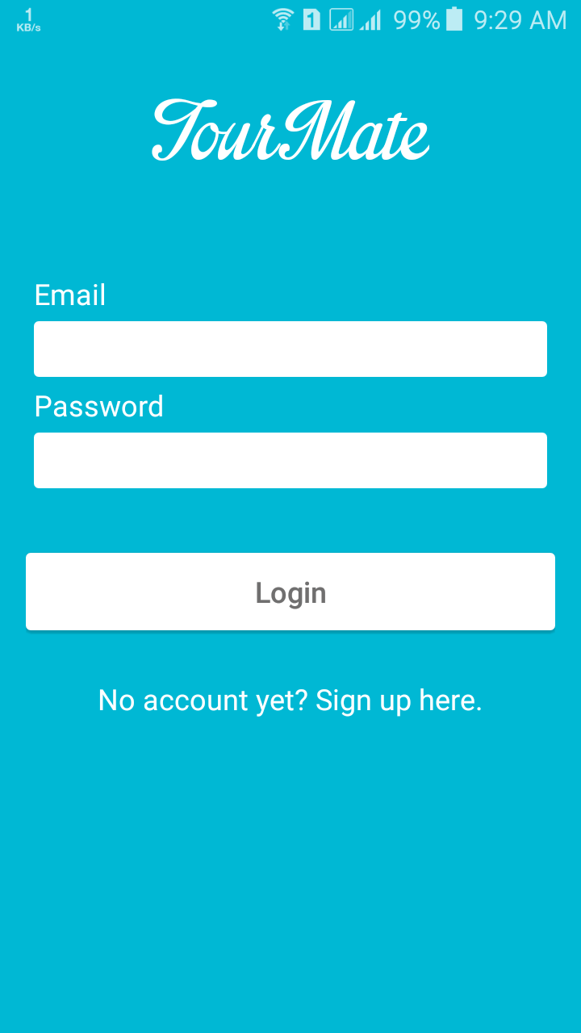
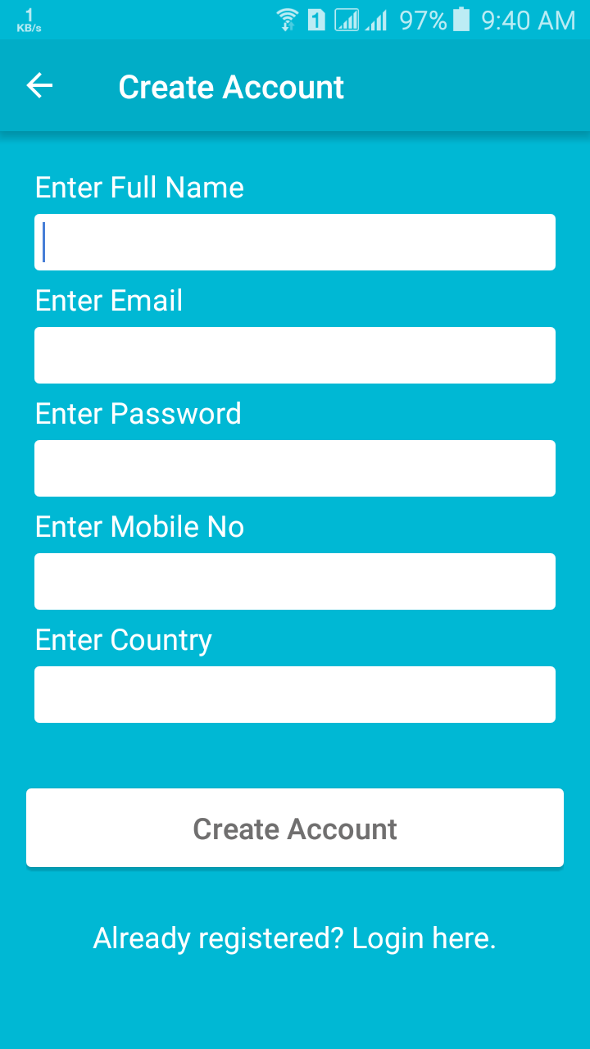
Main Interface

Slide 4
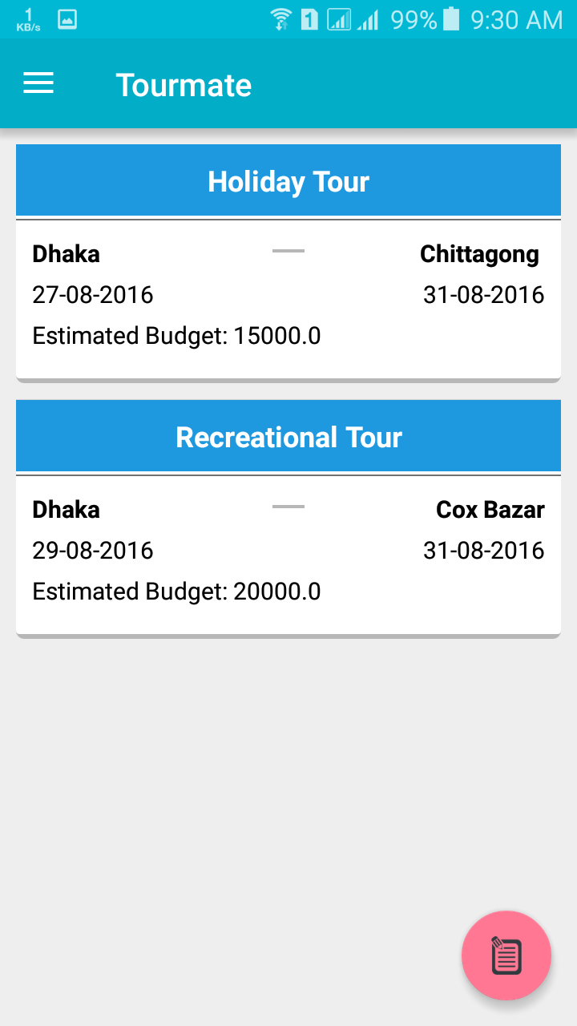
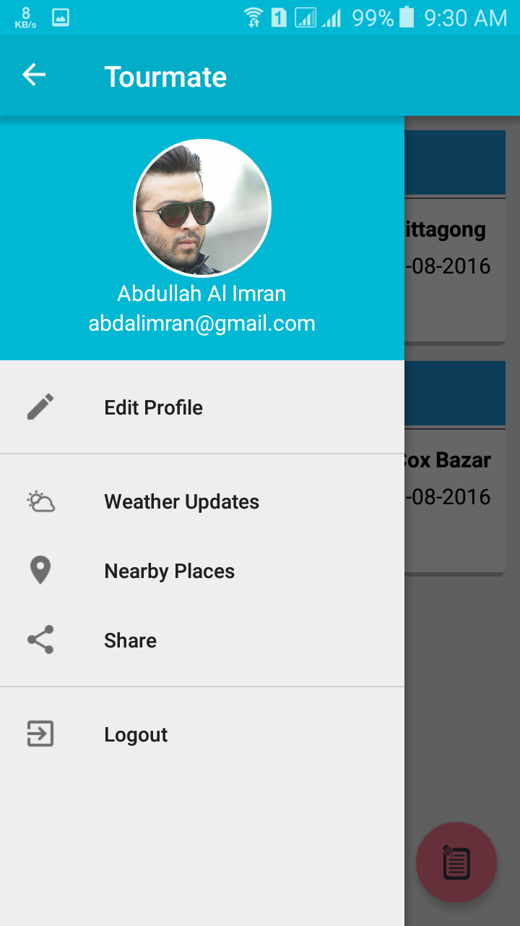
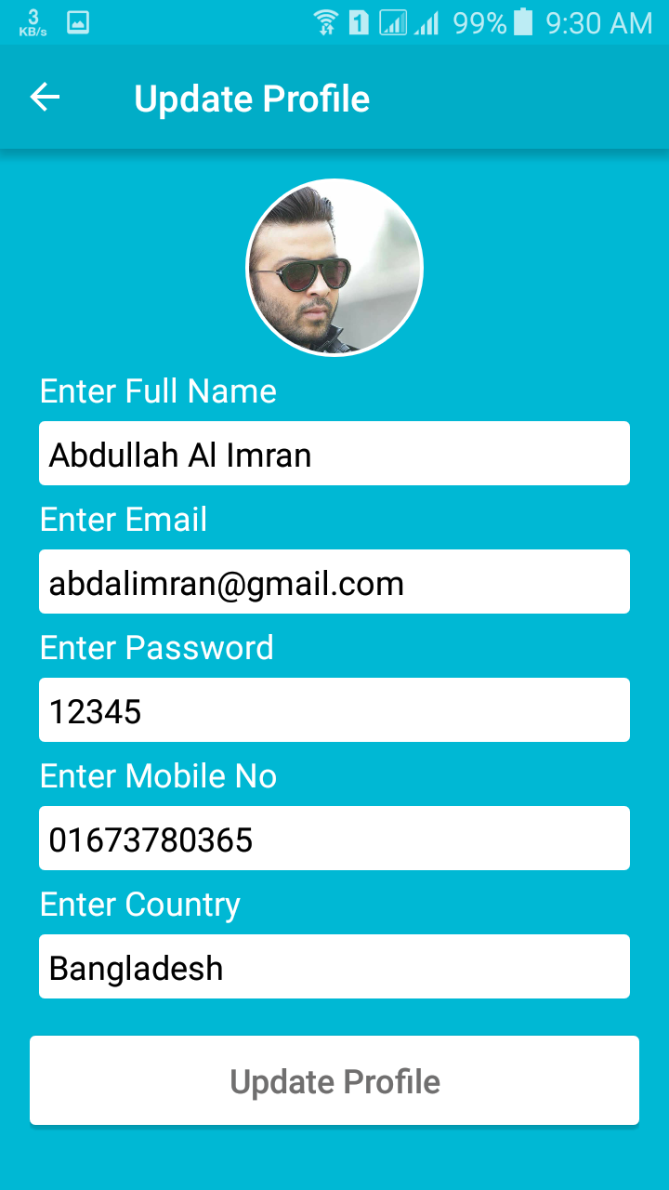

Slide 5
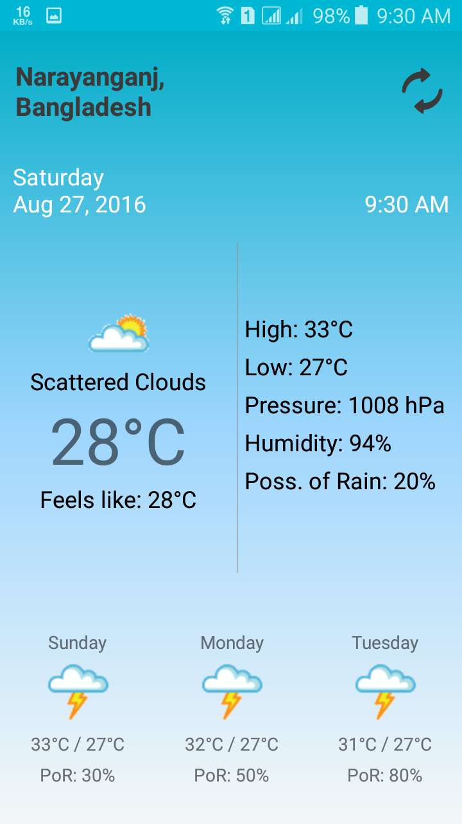
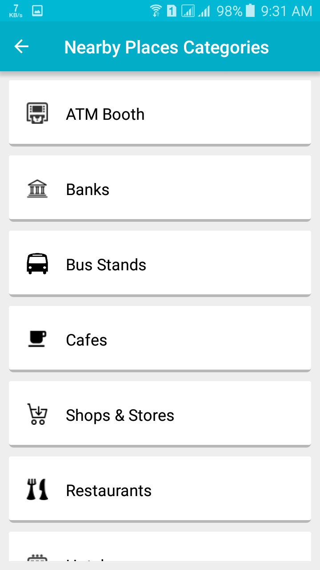
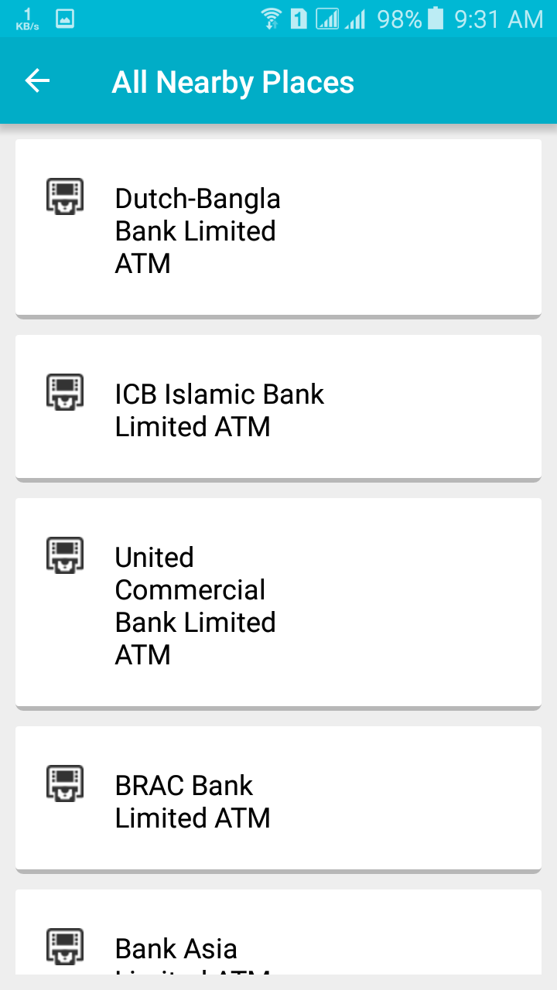

Slide 6
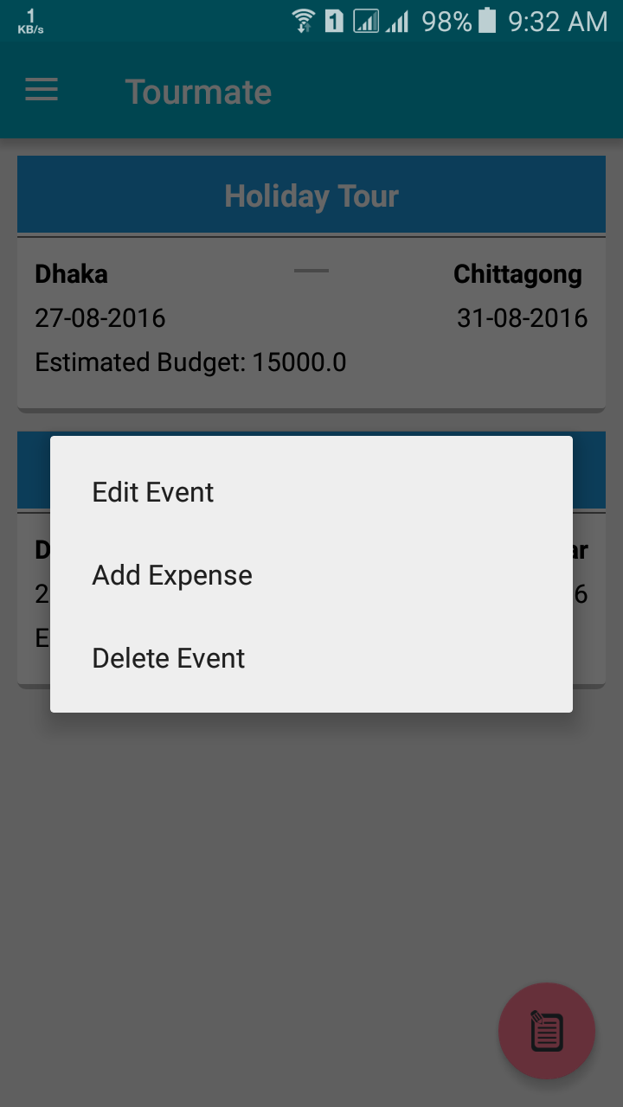
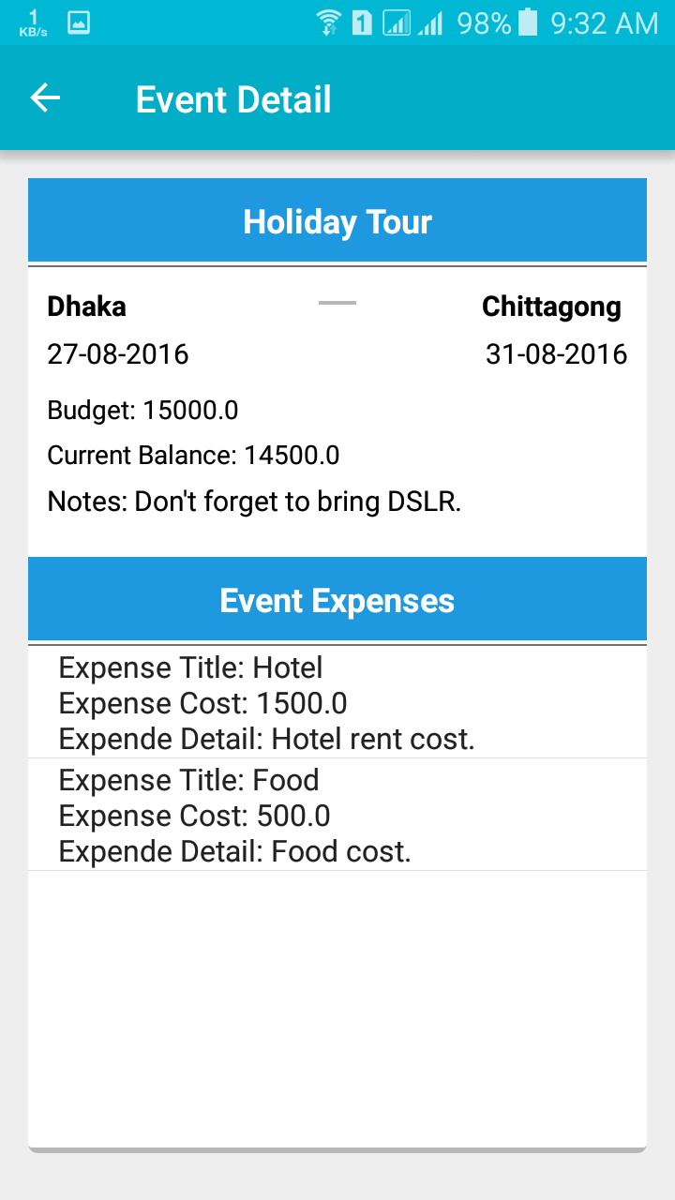
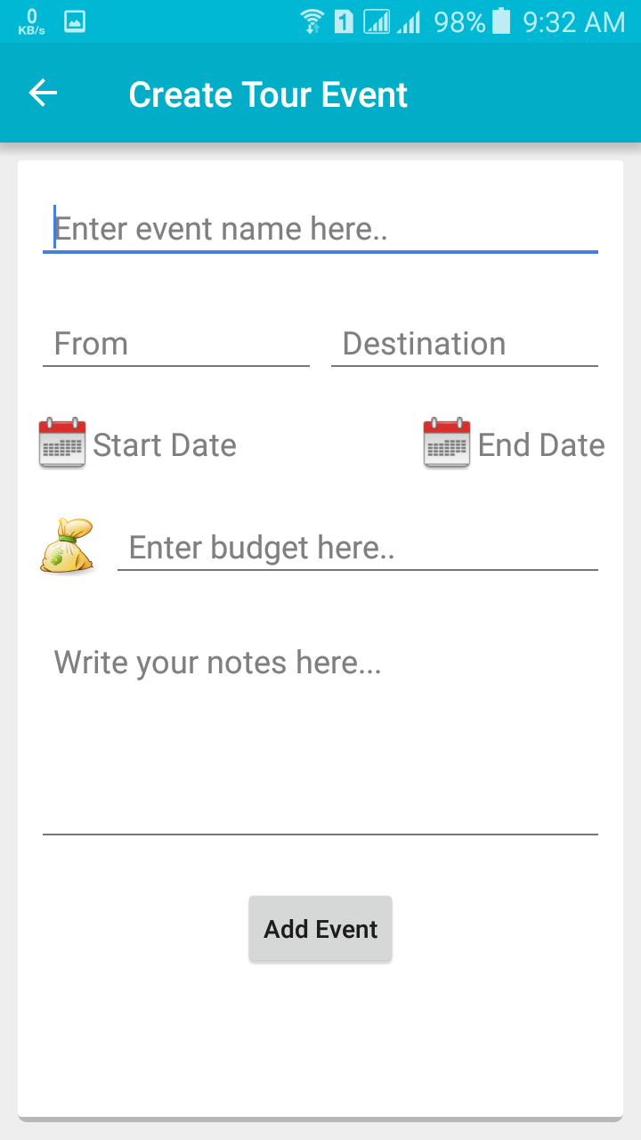

Slide 7
Any Question?

Slide 8

Thank you!!

